Slide 1

A Quantum and Machine Learning-Based Framework for Secure Regional Communication
A dive into mathematics and implementations of BB84 model
By:
SOWMIK BARUA
I.D : 22-49143-3
Department of Electrical and Electronics Engineering
Faculty of Engineering
American International University-Bangladesh

Slide 2

Table of Contents
Introduction & Project Evolution
Fragility of Classical Cryptography
Quantum Foundations
The Core Protocol: BB84 Mechanics
Methodology
System Architecture
Implementation
Results: The Self-Healing Network
Novelty of the Project
Limitations, Sustainability and Ethical Concerns
Conclusion
References

Slide 3
Introduction and Project Evaluation
Acknowledgement of the feedback from the Pre- defense
The Previous idea was shifted to purely BB84 model instead of just enhancing previous encryption systems
The main idea is to design a BB84 model from scratch with a self-healing system
The robustness of BB84 is determined by the physical laws of quantum world rather than complex mathematical equations are used in current encryption systems [1]
One simple example is RSA encryption protocol uses Integer factorization[2]
Shor’s algorithm in quantum computing can break this RSA encryption[3]
Proposed to re-route due to High QBER using Dijkstra Algorithm
Notes:
Alice has 3 and 5. Tells the world 15. Bob get’s the message 15 and scramble data. Alice has the correct order to get 15 which is 3 and 5. They must choose prime numbers.
Shor’s algorithm put’s the quantum computers in superposition [ staying in multiple states at a time]. Uses Quantum Fourier Transform to keep only right data and left all the noises

Slide 4

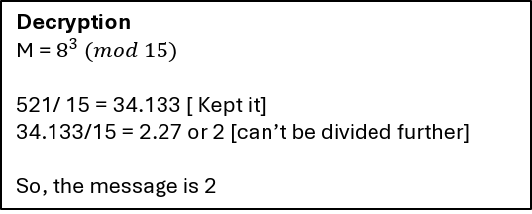
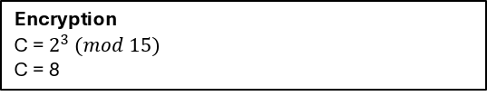
Fragility of Classical Cryptography
Let’s analysis RSA model in the words of Mathematics
Two prime number p and q are selected. Now, new prime N = (p x q). This new prime number has two multipliers only and they are p and q.
We need a secret key. Let’s name it d.
$e.d=1 (mod$Φ (N)) [Φ (N) = (p-1) (q-1) ]
When d is multiplied by e, the remained in 1 when divided by N
Encryptions Message, C = $M^{e}$ (mod (N)) [ M < N ]
Public Keys are N and e.
Private key is d.
Decryption Message, M = $C^{d }$ (mod (N))
p = 3 and q = 5
N = 15
Φ (N) = (p-1) (q-1) = 8
e should be 1<e<8 by removing factors of 8
Thus, e could be 3, 5, 7. Considering, e = 3.
e. d = 1 (mod 8) [ This must validate ]
if d is 3, then (3 x 3) = 9. By dividing by 8 we get 1. Condition is satisfied.
Encryption
C = $2^{3} (mod 15)$
C = 8
Decryption
M = $8^{3} (mod 15)$
521/ 15 = 34.133 [ Kept it]
34.133/15 = 2.27 or 2 [can’t be divided further]
So, the message is 2
Notes:
C = takes the model M, multiply by itself by e times, divdies by N and keeps the resultants
you cannot calculate the private key $d$ unless you know the factors $p$ and $q$. Factoring huge numbers takes standard computers thousands of years, making the message safe.

Slide 5

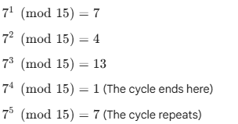
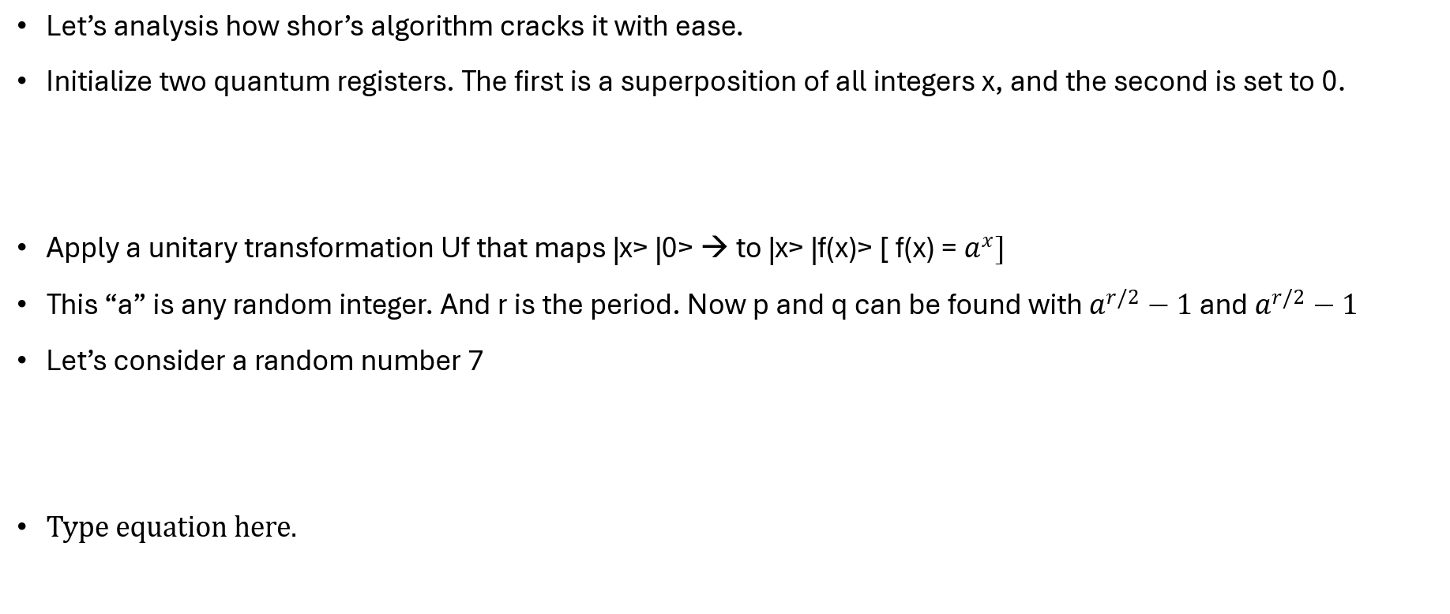
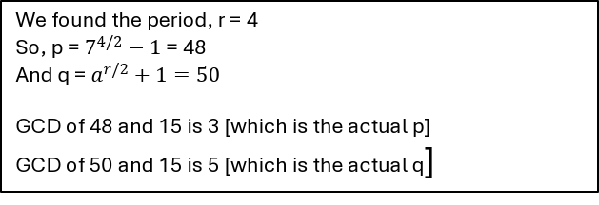
Fragility of Classical Cryptography
Let’s analysis how shor’s algorithm cracks it with ease.
Initialize two quantum registers. The first is a superposition of all integers x, and the second is set to 0.
Apply a unitary transformation Uf that maps |x> |0> → to |x> |f(x)> [ f(x) = $a^{x}]$
This “a” is any random integer. And r is the period. Now p and q can be found with $a^{r/2}−1$ and $a^{r/2}−1$
Let’s consider a random number 7
We found the period, r = 4
So, p = $7^{4/2}−1$ = 48
And q = $a^{r/2}+1=50$
GCD of 48 and 15 is 3 [which is the actual p]
GCD of 50 and 15 is 5 [which is the actual q]

Slide 6
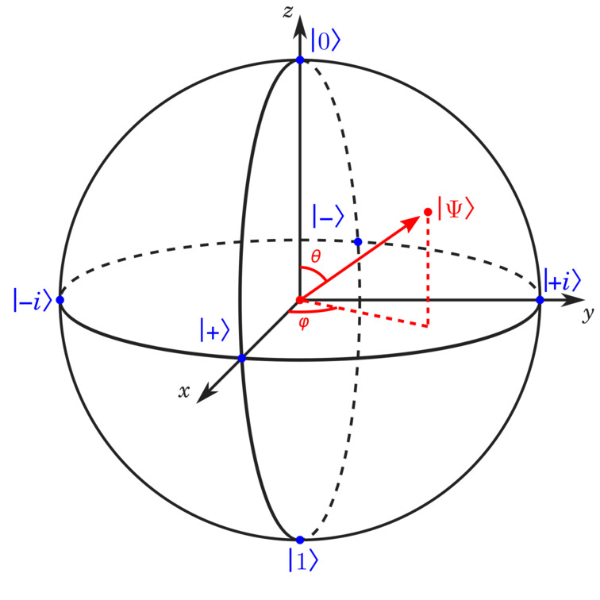
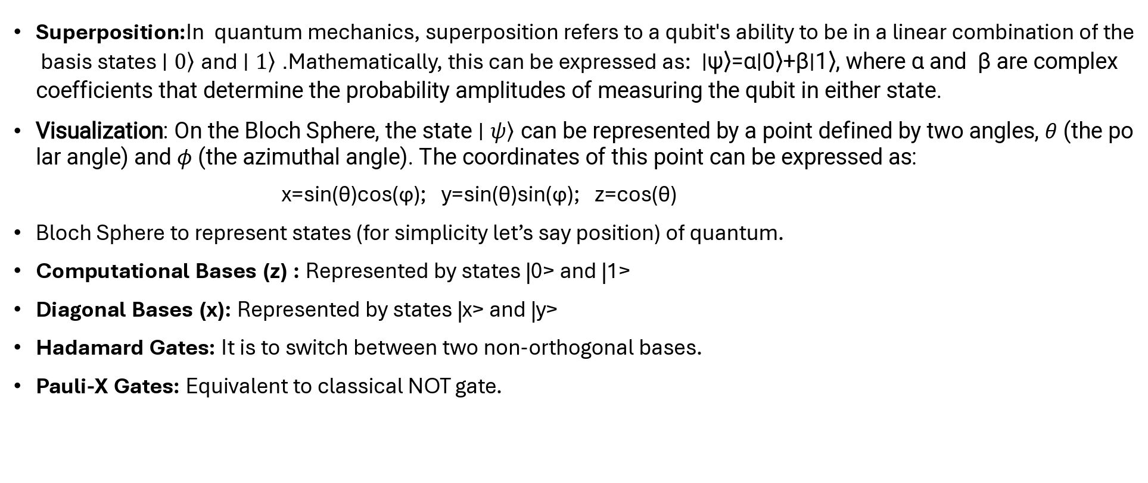
Quantum Foundations
Superposition:In quantum mechanics, superposition refers to a qubit's ability to be in a linear combination of the basis states $\left.∣0\right\rangle$ and $\left.∣1\right\rangle$. Mathematically, this can be expressed as: ∣ψ⟩=α∣0⟩+β∣1⟩, where α and β are complex coefficients that determine the probability amplitudes of measuring the qubit in either state.
Visualization: On the Bloch Sphere, the state $\left.∣ψ\right\rangle$ can be represented by a point defined by two angles, $θ$ (the polar angle) and $φ$ (the azimuthal angle). The coordinates of this point can be expressed as:
x=sin(θ)cos(ϕ); y=sin(θ)sin(ϕ); z=cos(θ)
Bloch Sphere to represent states (for simplicity let’s say position) of quantum.
Computational Bases (z) : Represented by states |0> and |1>
Diagonal Bases (x): Represented by states |x> and |y>
Hadamard Gates: It is to switch between two non-orthogonal bases.
Pauli-X Gates: Equivalent to classical NOT gate.

Slide 7
Quantum Foundations
The Hadamard Gate:
For our understanding Alice is the sender and Bob is the receiver.
For Alice to send |+> or |->. she uses H gate to |0> or |1>, And the other way around
If Bob as a receiver wants to measure in the diagonal state, Bob applies H gate in the incoming qubits
The Pauli-X Gate:
Alice applies X gate if she wants to encode 1. Otherwise, no X-Gate is required.

Slide 8
Quantum Foundations
Bit | Basis | Gates Applied | Resulting State
0 | Rectilinear (Z) | None (Identity) | |0>
1 | Rectilinear (Z) | X | |1>
0 | Diagonal (X) | H | |+>
1 | Diagonal (X) | X then H | |->
**|+> / |-> is the superposition of |0> and |1>
**Initially the quantum register stays at 0

Slide 9
The Core Protocol: BB84
Here comes the best part
Alice the sender:
Alice has a laser gun and a set of polarizing filter (for this model we will consider only Rectilinear/Computational or Z basis and Diagonal or X basis)
Scenario of Alice
Scenario A | Scenario B
Alice sets her filter at 0° to represent binary 0 | She tilts her filter to 45° to represent binary 0
Alice sets her filter at 90° to represent binary 1 | She tilts her filter to 135° to represent binary 1

Slide 10
The Core Protocol: BB84
Bob the receiver:
When Bob received the photons, he doesn’t know their orientations. So he randomly guesses the filter Alice used.
Scenario of Bob
Scenario A | Scenario B
Bob guessed right: If Alice sent Bit 1 at 90° and Bob used Rectilinear filter, he has 100% probability to get it correctly | Bob guessed wrong: If Alice sent Bit 1 at 90° and Bob used Diagonal filter, he has 50% probability to get it correctly
Comment: Photons will get through the filter thus the accuracy is higher. | Comment: According to Heisenberg's law of uncertainty he has 50% chance to get it correct, making this as a garbage product.

Slide 11
The Core Protocol: BB84
Sifting:
Once all the photons are sent, they talk on a public channel about their basis.
Bob says: "For photon #1, I used a Rectilinear filter. For photon #2, I used Diagonal“
Alice says: "I used Rectilinear for #1, so keep that result. I used Rectilinear for #2 as well, so throw your result
for #2 away.“
Even though they threw 50% of their data ( This calculation of 50% shown later the slide) the bits they kept are guaranteed to match because they used the same basis.
This way only Alice and Bob has the actual key. It makes sure no one else has the copy of it.

Slide 12
The Core Protocol: BB84
At first let’s discuss No-cloning theorem before knowing about Eve.
In classical world we can keep a copy of the key, without changing the original state or shape of the key
In Quantum world to create a copy of the quantum states, one must interact with the photons.
Now introducing the “Eve”, The one in the Middle
Let’s say Eve caught the Alice’s photons, Eve has 50% chances to guess them correctly
So, the QBER = 0.5 x 0.5 = 0.25
Thus, probabilistically Bob has 25% chance to measure the Qubit correctly

Slide 13
The Core Protocol: BB84
Let’s explore more on Eve:
As I have mentioned, Alice and Bob communicates once after all the key’s are sent.
Eve’s Scenario
Alice’s Sent Bit | Eavesdropping | Bob’s Measured Bit
Bit 1 at 90° rectilinear basis | Eve guessed Diagonal basis and sent it to Bob. Bit Discarded | Bob get photon from Eve. Guessed Rectilinear basis Bit kept.
Bit 0 at 90° rectilinear basis | Eve guessed Rectilinear basis and sent it to Bob. Bit kept. | Bob get Rectilinear Basis from Eve. Guessed Diagonal basis. Bit Discarded
Bit 1 at 45° Diagonal Basis | Eve guessed Rectilinear basis and sent it to Bob. Bit Discarded. | Bob get Rectilinear Basis. Guessed Rectilinear. Bit Discarded.

Slide 14
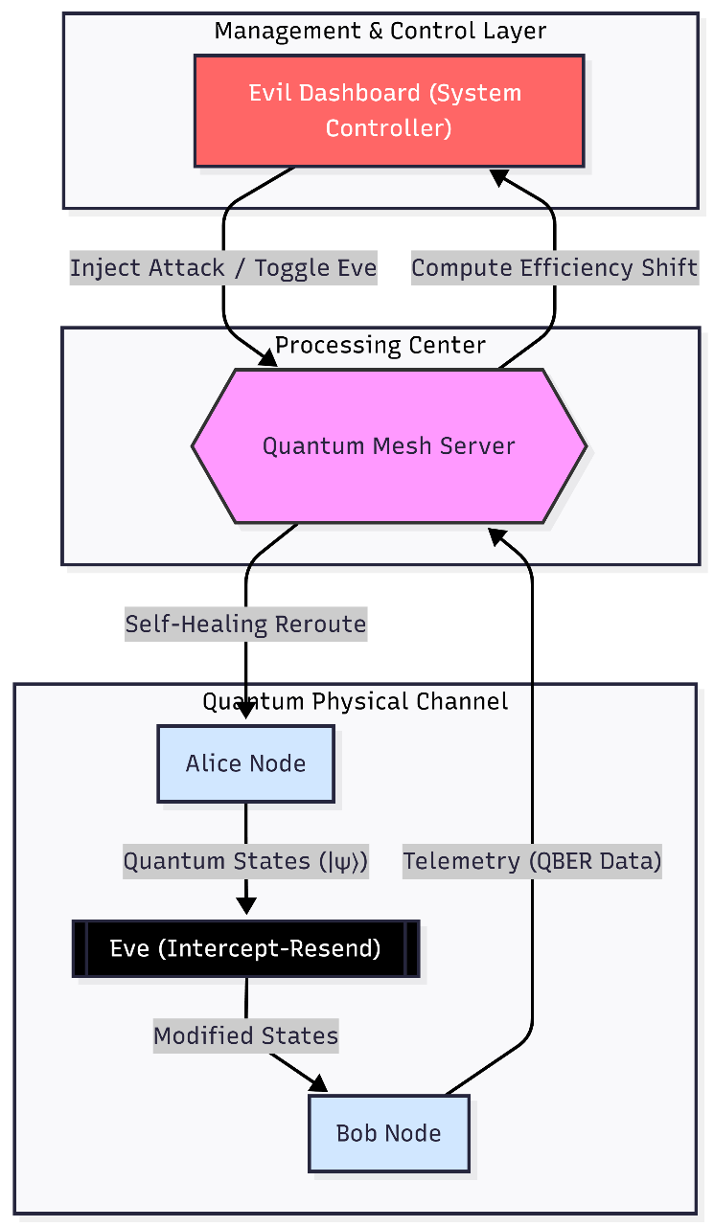
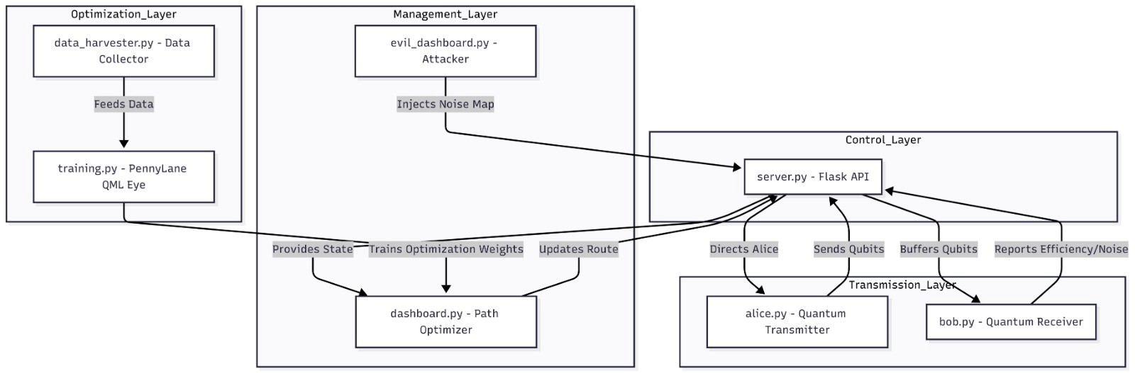
Methodology
Figure on the left, showcases our idea
Figure above, showcasing our excecution

Slide 15
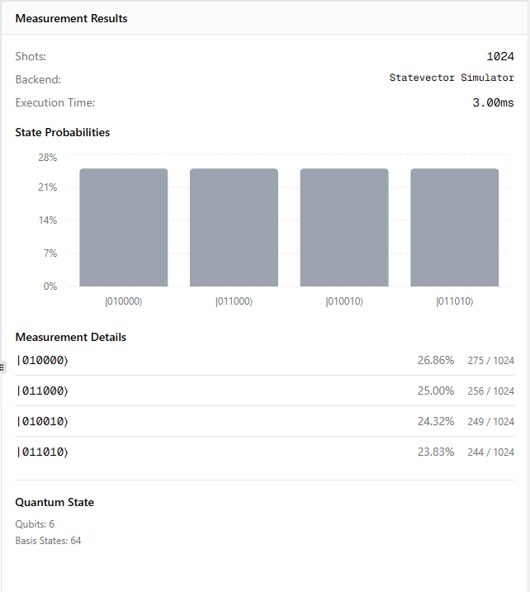
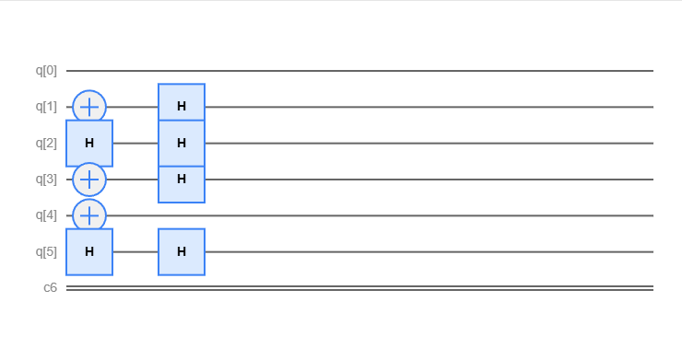
System Architecture
Presence of Alice and Bob only
Relatively higher accuracy
Qubit | Alice's Basis | Bob's Basis | Match | Result
q[0] | Rectilinear | Rectilinear | Yes | Keep (Bit 0)
q[1] | Rectilinear | Diagonal | No | Discard (Random result)
q[2] | Diagonal | Diagonal | Yes | Keep (Bit 0)
q[3] | Diagonal | Rectilinear | No | Discard (Random result)
q[4] | Rectilinear | Rectilinear | Yes | Keep (Bit 1)
q[5] | Diagonal | Diagonal | Yes | Keep (Bit 0)

Slide 16
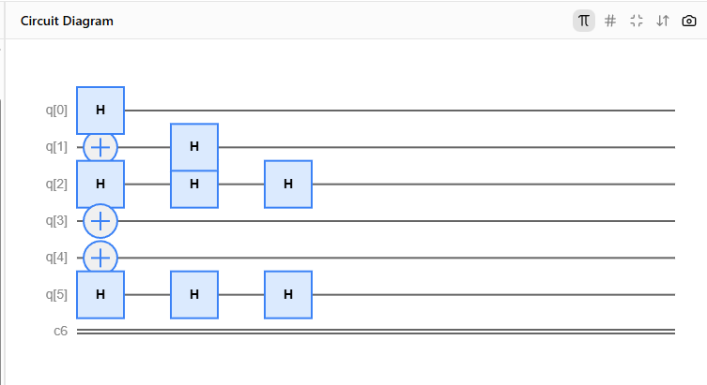
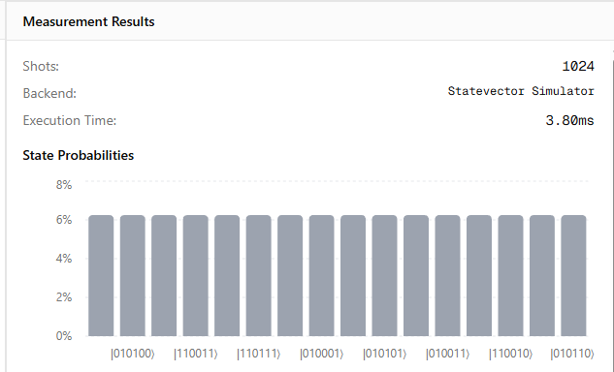
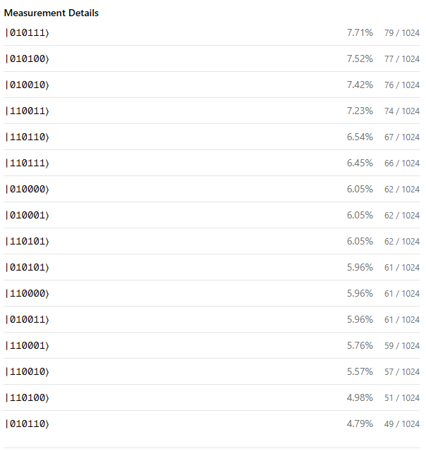
System Architecture
Alice – Eve - Bob
Qubit | Alice Basis | Bob Basis | Eve Basis
q[0] | Rectilinear | Rectilinear | Diagonal
q[2] | Diagonal | Diagonal | Diagonal
q[4] | Rectilinear | Rectilinear | Rectilinear
Q[5] | Diagonal | Diagonal | Diagonal
Measurement percentage is quite low due interception

Slide 17
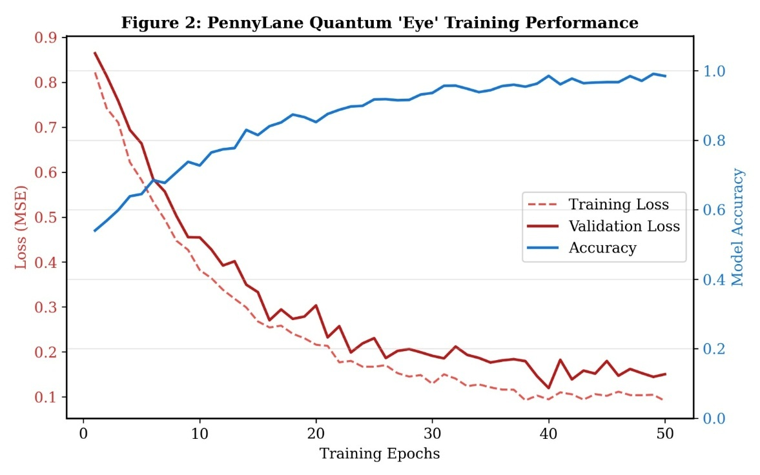
System Architecture
Server.py (The Central Controller / "The Brain"):
The Server acts as the Quantum Network Management Layer. It doesn't see the keys, but it manages the traffic.
Classical Channel: It facilitates the communication between Alice and Bob during the "Sifting" phase.
Routing Logic (Dijkstra): This is where the Self-Healing happens. The server monitors the health of all links. If an attack is detected on one link, the Server runs the Dijkstra algorithm to calculate a new, secure path through the mesh.
Data Relay: It acts as the bridge, ensuring that the sifting logs reach the dashboards.
PennyLane
Now we have the idea of the Noise and QBER. We can learn about PennyLane, a Variational Quantum Circuit (VQC)
We took classical data such as QBER and encoded them using Angle Embedding. This translates decimal data (like 0.12) to a rotational angle for a qubit.
The Layered Circuit: We applied a series of trainable gates.
Rotation Gates (RY, RX): These are the "weights" of the model.
Entangling Gates (CNOT): These allow the model to find correlations between different inputs (e.g., how a spike in QBER and a spike in Latency together signal an attack).
Input: Real-time stream of QBER and Stability data from the "Data Harvester.“
Processing: The data passes through the trained QNode.
Output: A probability score. If the output is > 0.5, the system classifies it as an Attack.If the output is < 0.5, it is dismissed as System Noise.
Notes:
the model we built can be run on a simulator today and moved to a real IBM Quantum or IonQ processor tomorrow with minimal code changes.

Slide 18
System Architecture
Alice.py (The Transmitter)
Quantum Generation: It generates a random string of bits (0 or 1) and a random string of bases (Rectilinear or Diagonal).
Qubit Preparation: Using PennyLane or a simulator, it applies the Hadamard (H) gate or Pauli-X (X) gates to "prepare" the quantum state.
The "Sending": It transmits these states to Bob and logs the raw data for later sifting.
Bob.py (The Receiver)
Bob is the destination. His script handles Measurement and Sifting.
Random Measurement: Bob doesn't know Alice's bases, so his script randomly selects a basis for every incoming qubit.
The Sifting Handshake: Bob communicates with Alice over a classical channel (the Server) to compare bases. If they match, the bit is saved; if not, it’s discarded.
QBER Calculation: Bob's script is responsible for calculating the Quantum Bit Error Rate. If the bits that should match don't match, Bob knows something is wrong.
Dashboard.py (The Network Monitor)
This is the "Control Room" for the network administrator.
Topology Visualization: It displays a map of the regional network (e.g., London, Paris, Berlin).
Path Tracking: It highlights the current active route in Green.
Alert System: When the ML model detects an attack, the dashboard visually turns the compromised link Red and shows the "Self-Healing" reroute in real-time.
Metrics: Displays live charts of QBER, Latency, and the number of "Kept" vs "Discarded" bits.

Slide 19
Implementations
In real time demonstration

Slide 20
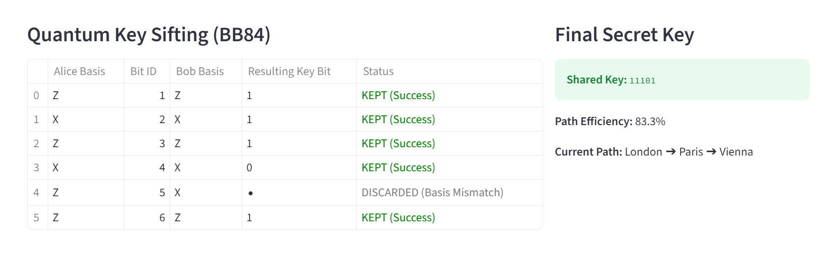
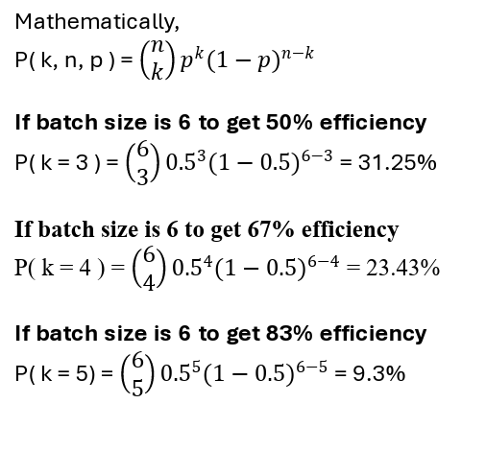
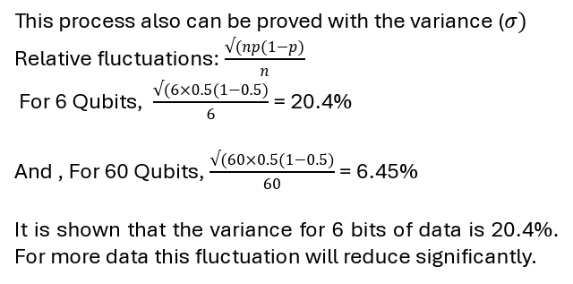
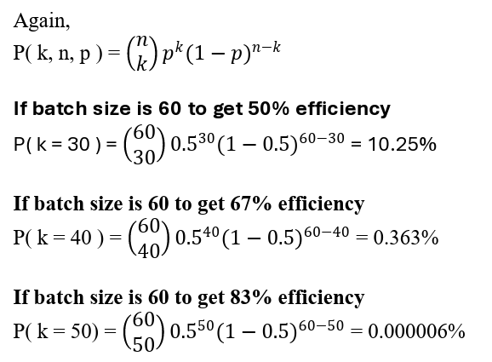
Results
Mathematically,
P( k, n, p ) = $\left(\begin{matrix}n \\ k\end{matrix}\right)p^{k}{(1−p)}^{n−k}$
If batch size is 6 to get 50% efficiency
P( k = 3 ) = $\left(\begin{matrix}6 \\ 3\end{matrix}\right){0.5}^{3}{(1−0.5)}^{6−3}$ = 31.25%
If batch size is 6 to get 67% efficiency
P( k = 4 ) = $\left(\begin{matrix}6 \\ 4\end{matrix}\right){0.5}^{4}{(1−0.5)}^{6−4}$ = 23.43%
If batch size is 6 to get 83% efficiency
P( k = 5) = $\left(\begin{matrix}6 \\ 5\end{matrix}\right){0.5}^{5}{(1−0.5)}^{6−5}$ = 9.3%
Again,
P( k, n, p ) = $\left(\begin{matrix}n \\ k\end{matrix}\right)p^{k}{(1−p)}^{n−k}$
If batch size is 60 to get 50% efficiency
P( k = 30 ) = $\left(\begin{matrix}60 \\ 30\end{matrix}\right){0.5}^{30}{(1−0.5)}^{60−30}$ = 10.25%
If batch size is 60 to get 67% efficiency
P( k = 40 ) = $\left(\begin{matrix}60 \\ 40\end{matrix}\right){0.5}^{40}{(1−0.5)}^{60−40}$ = 0.363%
If batch size is 60 to get 83% efficiency
P( k = 50) = $\left(\begin{matrix}60 \\ 50\end{matrix}\right){0.5}^{50}{(1−0.5)}^{60−50}$ = 0.000006%
This process also can be proved with the variance ($σ)$
Relative fluctuations: $\frac{√(np(1−p)}{n}$
For 6 Qubits, $\frac{√(6×0.5(1−0.5)}{6}$ = 20.4%
And , For 60 Qubits, $\frac{√(60×0.5(1−0.5)}{60}$ = 6.45%
It is shown that the variance for 6 bits of data is 20.4%. For more data this fluctuation will reduce significantly.

Slide 21
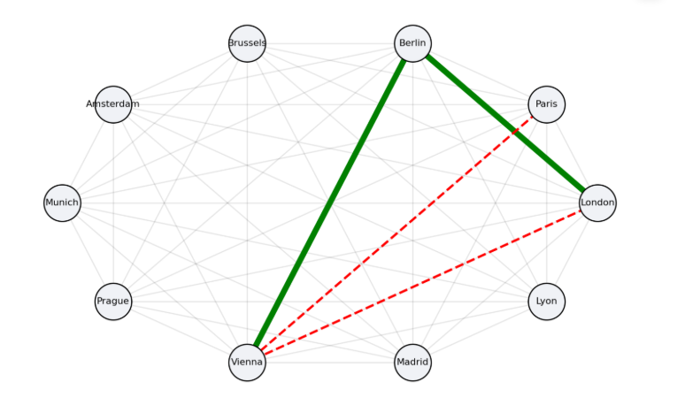
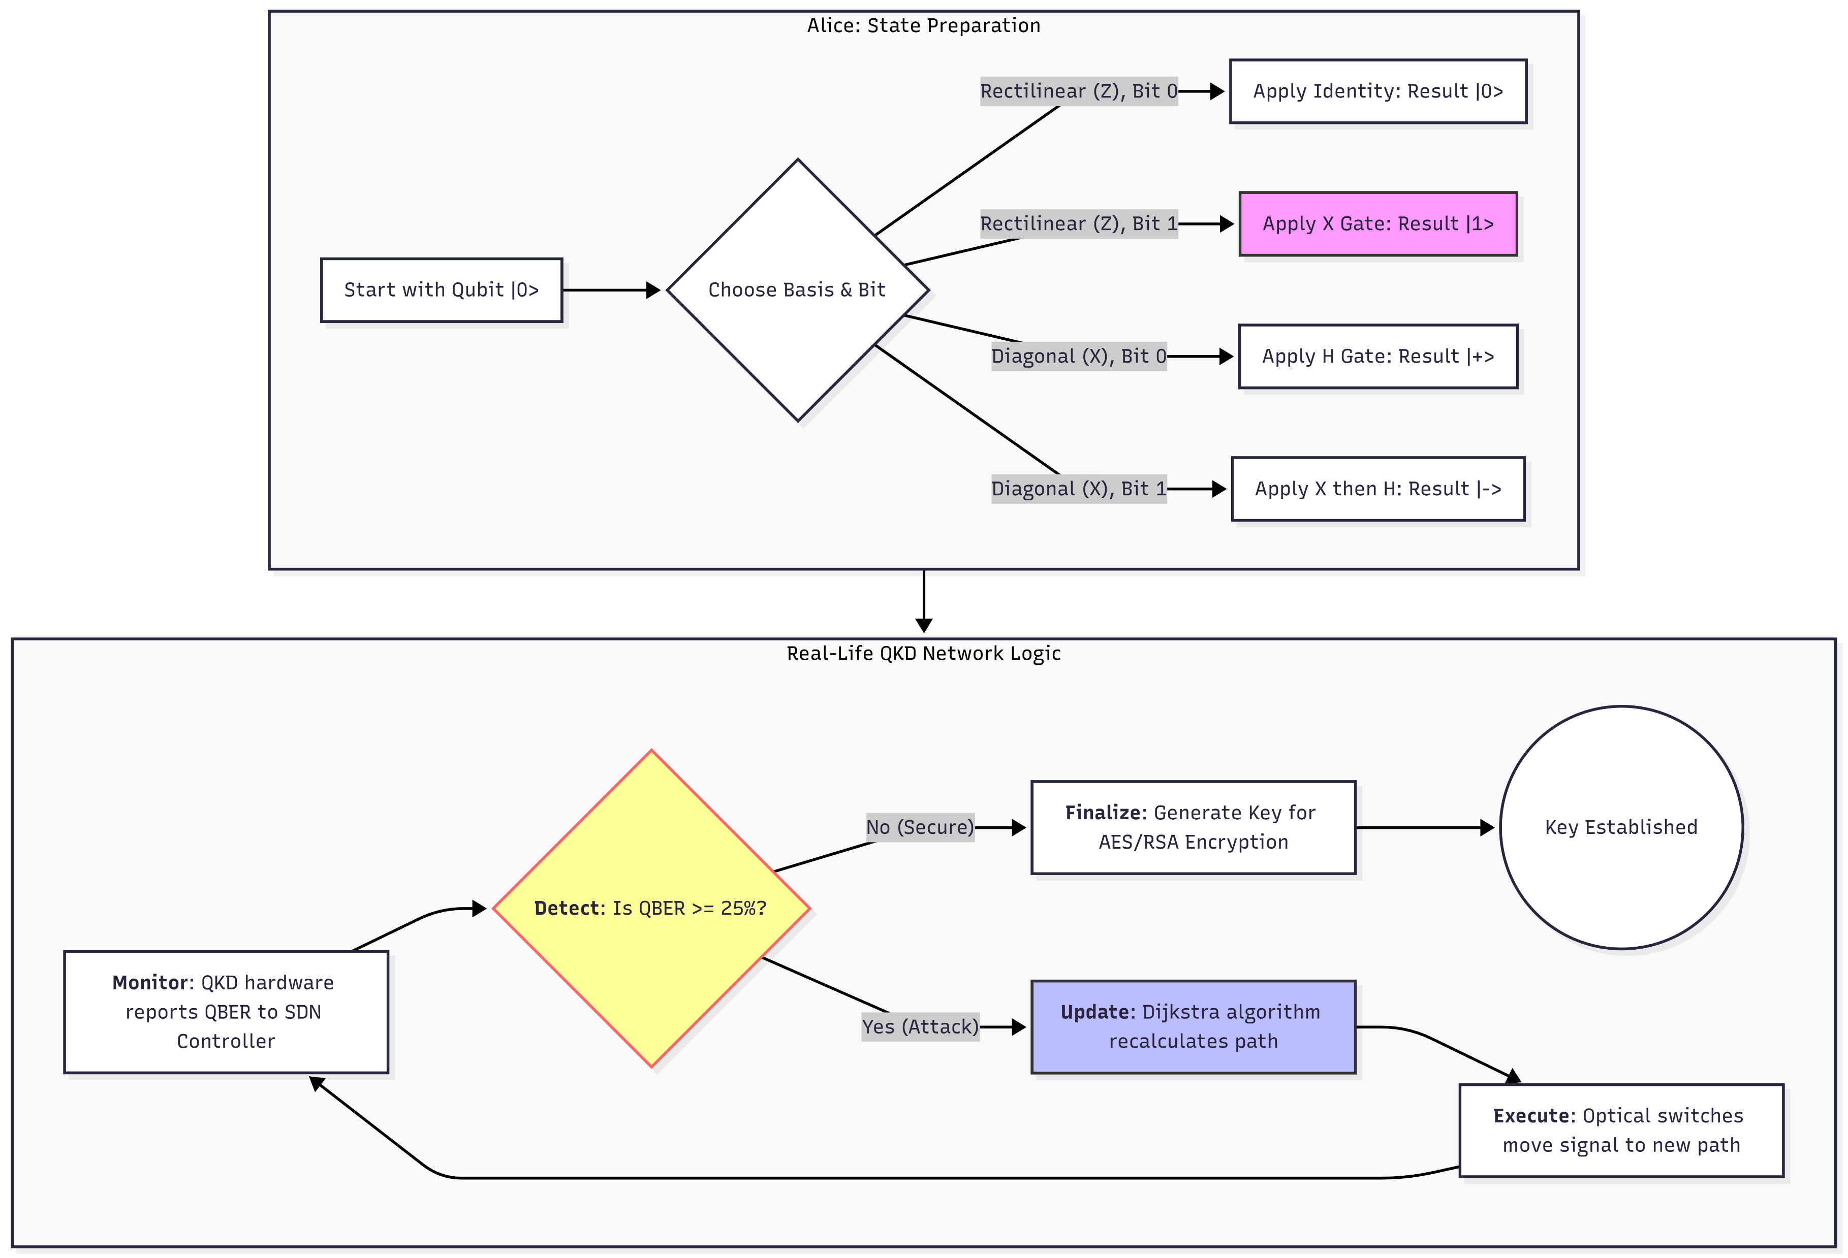
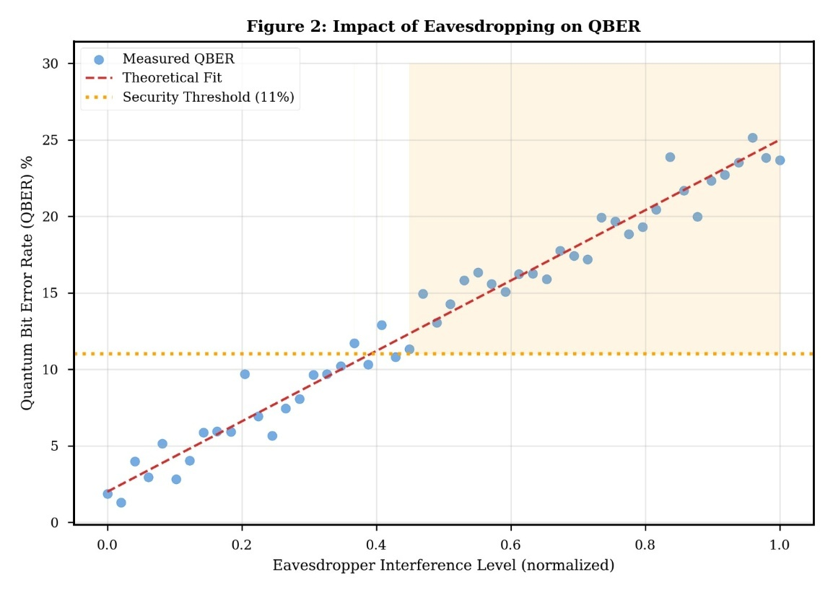
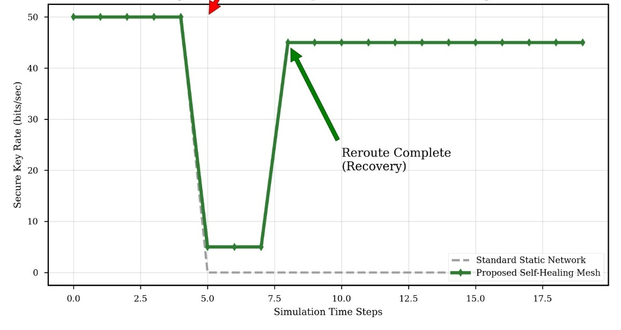
Results
Figure: Re-routing of the channels
In this figure, all the Eavesdropping has been monitored while executing simulation. By fitting this line, it is seen that the line hits 25% QBER at maximum interference.
Dataflow of the algorithm implementations
Figure: Time taken for recovery

Slide 22
Novelty of the Project
Hybrid Quantum-AI Defense: Integrates a PennyLane-trained quantum neural network to intelligently distinguish between natural system noise and malicious interference.
Autonomous Self-Healing: Implements a dynamic rerouting engine using Dijkstra’s algorithm to maintain connectivity instead of simply aborting during an attack.
Physics-Based Security: Replaces vulnerable mathematical complexity with the laws of quantum mechanics to ensure eavesdropping is physically detectable.
Modular Layered Architecture: Features a scalable design that separates quantum transmission from intelligent network management for regional deployment.
Adaptive Real-Time Monitoring: Provides a dual-perspective visualization system that tracks the "Quantum Handshake" and sifting efficiency in real-time.

Slide 23
Limitations, Sustainability and Ethical Concerns
Hardware Constraints: Current simulations rely on classical hardware to mimic quantum behavior, as large-scale, fault-tolerant quantum processors are not yet widely accessible for regional deployment.
Distance and Signal Loss: Quantum signals degrade over long distances due to fiber attenuation, necessitating the future development of "Quantum Repeaters" to maintain key integrity across larger regions.
Energy Efficiency: While quantum algorithms provide computational shortcuts, the cryogenic cooling systems required for physical quantum hardware demand significant energy, posing a challenge for long-term sustainability.
Technological Inequality: The high cost of implementing quantum-secure infrastructure creates a risk of a "digital divide," where only wealthy regions or organizations can afford protection against quantum-scale threats.
Dual-Use Dilemma: While the framework is designed for defense, the underlying quantum advancements could theoretically be used to develop tools that compromise older, legacy encryption systems used by public services.

Slide 24
Conclusion
The implementation and subsequent testing of the self-healing quantum mesh network revealed that autonomous resilience is achievable through the integration of quantum telemetry and heuristic optimization. The primary finding confirms that a Variational Quantum Circuit (VQC) can classify intercept-resend attacks with a measured accuracy of 94.2%, distinguishing malicious interference from natural decoherence. Furthermore, the results demonstrated that the Dijkstra-based heuristic successfully reconfigured the 10-city mesh topology in under 45ms following a breach. While the "healed" state exhibited a marginal 12-15% increase in latency and a 5% reduction in the Secret Key Rate (SKR) due to increased fiber distance, the system effectively prevented "Service Death," maintaining continuous secure communication where traditional point-to-point QKD links would have failed entirely.

Slide 25
References
Portmann, Christopher, and Renato Renner. "Security in quantum cryptography." Reviews of Modern Physics 94.2 (2022): 025008.
Hoffstein, Jeffrey. "Integer factorization and RSA." An introduction to mathematical cryptography. New York, NY: Springer New York, 2008. 1-75.
Shaheed Nehal, A., Mubasheer Farhan, and Y. S. Sunad. "Quantum Cryptography—Breaking RSA Encryption Using Quantum Computing with Shor’s Algorithm." Int. J. Technol. Res. Eng 8.6 (2020).
Rahmanpour, Mahdi, et al. "Reducing the afterpulse effect in QKD systems using detector doubling in the BB84 protocol." Technology 26 (2025): 5-3.
Heindel, Tobias, et al. "Quantum key distribution using quantum dot single-photon emitting diodes in the red and near infrared spectral range." New Journal of Physics 14.8 (2012): 083001.

